Slide 1
SmartHeat 🔥😎
Or Shahar 313195216
Hadar Kimel 313559056
GitHub

Slide 2
Introduction - What is SmartHeat?
We thought about the concept of SmartHeat- a smart water heater- when we were on our way home from a camping trip. It was during the winter and we had a 2 hour drive ahead of us. we thought how nice it would be if during our drive the water heater would heat our water so we could get in the shower immediately, instead of only turning it on manually when we get home and having to wait.

Slide 3
What is IOT (Internet of Things)?
The Internet of Things (IoT) describes the network of physical objects (the “things”) that are embedded with sensors, software and other technologies for the purpose of connecting and trading data with other devices over the internet. These devices range from ordinary household objects for everyday use to sophisticated industrial tools.

Slide 4

Goals
Our main goal is to use IOT concepts and practices to allow our users to have full control over their water heater anytime, from anywhere. 🌎
We also aspire to support our app on all types of smart devices (smartphones, tablets and more).

Slide 5
Potential Customers
Private households 🏠
Eco-Conscious Consumers 🌱
Locations that offer showering facilities (like gyms, swimming pools, hotels) 🚿
Tech enthusiasts who embrace smart home technology 💻
Busy individuals 💼
Frequent Travelers 🍹

Slide 6
Functional requirements
Mobile App Integration & Remote control- The app must seamlessly connects to the SmartHeat sensor.
Real-time response- SmartHeat must provide continuous information about the water heater status.
Alerts and Notifications- to inform users of any issues or maintenance requirements.
Usability- User-Friendly Interface & Multi-User Access.
Compatibility with Different Water Heater Types and a variety of mobile devices and operating systems.
Energy Monitoring & Holiday Mode- A feature that allows users to set the water heater to vacation mode to save energy.

Slide 7
Non-functional requirements
Reliability- The smart water heater should operate consistently without unexpected failures or downtime.
Network Connectivity- SmartHeat should seamlessly switch between various network types, ensuring continuous communication.
Scalability- The system should be designed to accommodate future upgrades or expansions, such as additional sensors or connectivity options.
Privacy- User privacy should be respected, and data collected by the smart water heater should be handled in compliance with relevant privacy regulations.
Response Time- The system's response time to user commands or alerts should be fast and effective.
Firmware and Software Updates, Warranty and Customer support- Clear warranty terms and accessible customer support channels to assist users with any issues or questions.

Slide 8
Main Features
The SmartHeat system is web based and can be accessed via your preferred device’s internet connection.
The sensor controls the water heater manually or follows the app’s commands that it gets via the broker.
Multiple users so you can share the control with your family or roommates.
Getting push notifications anytime the water heater is turned on or off. (optional)
Saving money by automatically turning off the water heater and reducing electricity usage.
For businesses- Regulatory compliance and environmental responsibility.

Slide 9
Development Plan
Architecture and Planning
Assembling
Infrastructure & Software development
Testing
Marketing & Distribution
Defining and designing the product
Building the hardware of the product (sensors and other components)
Developing the product
Performing different tests on the software
Advertising and getting the product to market
1
2
3
4
5

Slide 10
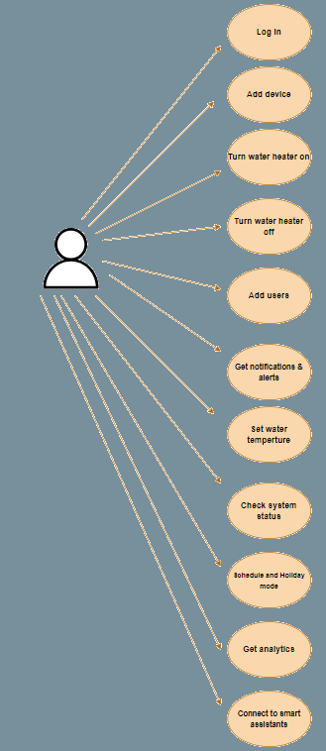
Use-case

Slide 11
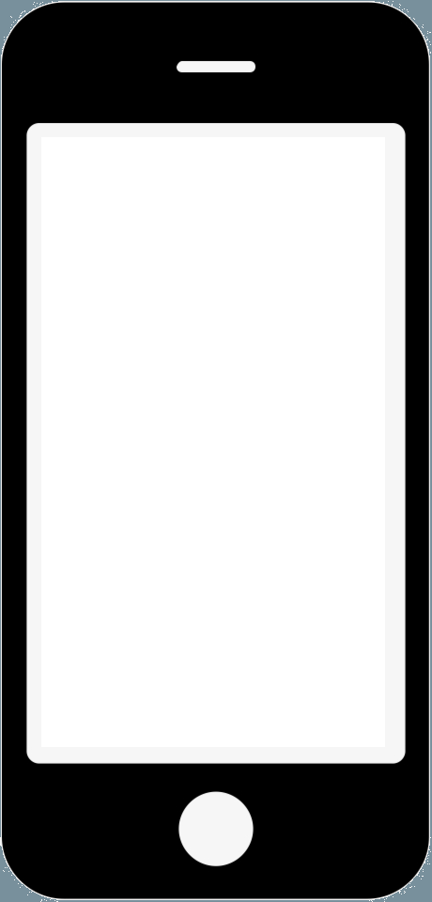
Architecture
MQTT Cloud broker
Publish events
Publish commands
Subscribe commands
Subscribe events
SmartHeat Sensor
🔥
SmartHeat Database
SmartHeat App

Slide 12
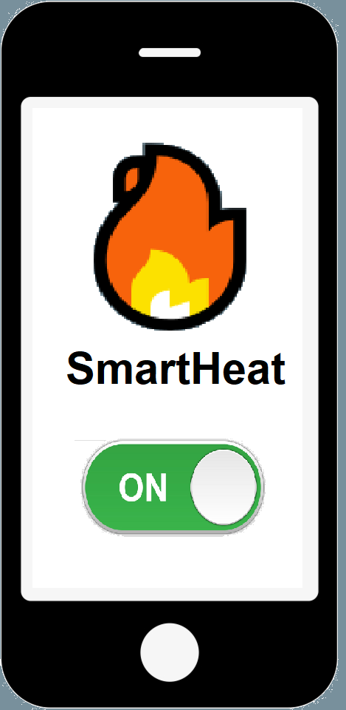
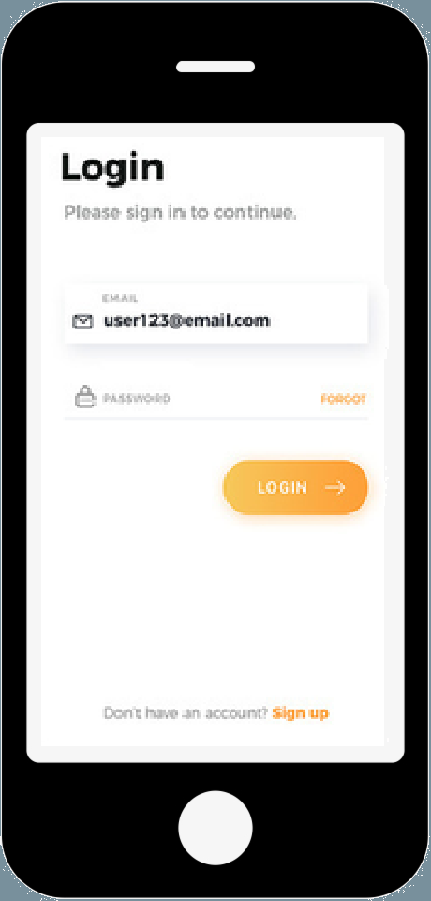
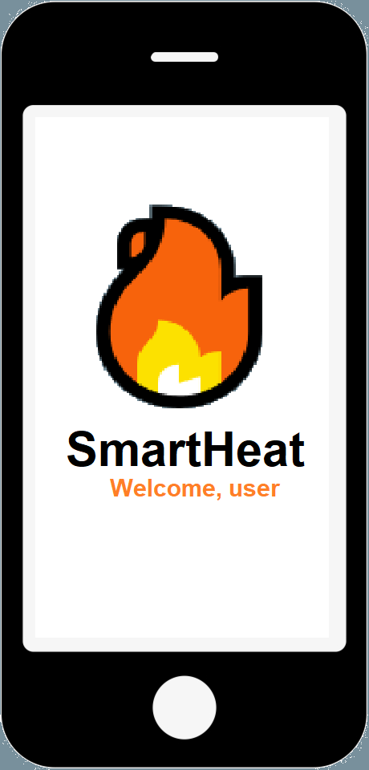
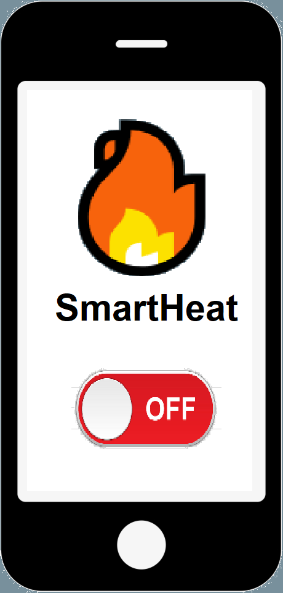
The SmartHeat App (Proof of concept)
Button screens for turning on/off
Login Screen
Home Screen

Slide 13
Setup
Replace the “dumb” water heater button to our SmartHeat sensor in your home.
Connect it to the internet via your home network.
Pair the SmartHeat sensor with the app.
Use the SmartHeat app on your smartphone to control your water heater.

Slide 14
Risks
Potential unauthorized access and privacy violations.
Dependency on stable internet connectivity for system functionality.

Slide 15
Future Features
Planning the schedule for the water heater activity.
Connect SmartHeat to virtual assistants like Alexa or Google Assistant.
In-depth monthly analytics regarding usage and expanses (using the database).

Slide 16
Sources
What Is the Internet of Things (IoT)? | Oracle

Slide 17
Thank You! 🔥😎

